Slide 1
Cloud Kitchen
Anirudh V 190330014
Anvesh Bemore 190330015
Sai Pradeep K 190330104
Vikram Kadarla 190330116

Slide 2
CONTENT
1. About
2. Concept
3. Objectives
4.Scope
5. Libraries
6.Model
7. Design
8. System requirements: 9.Hardware and Software
10.Conclusion

Slide 3
Concepts
A cloud kitchen is a concept of delivery only restaurant with no physical space, no dine-in space or takeaway counter. It is a restaurant kitchen that accepts delivery only orders without a traditional restaurant or dining-in facility. Just an operational kitchen for the preparation of food that functions as a production unit. No fancy infrastructure, no waiters, no tables, no furniture, nothing at all.
Customers can place their orders online through the online food aggregator apps or the restaurant app, hence, the name cloud kitchen.
These kitchens are sometimes also known as ghost kitchens, dark kitchens or virtual kitchens.

Slide 4
Objectives
The objective of these kitchens is to add value to the customers. Many of these customers buy daily from these kitchens. Hence, they are very concerned about the quality of inputs that are used since it directly impacts their health. This is the reason why cloud kitchens focus on food quality.

Slide 5
SCOPE
With increased internet penetration and the age of millennials with disposable income demanding digital, mobile-friendly solutions, the trend of virtual restaurants (delivery-only brands) has lately garnered attention.

Slide 6
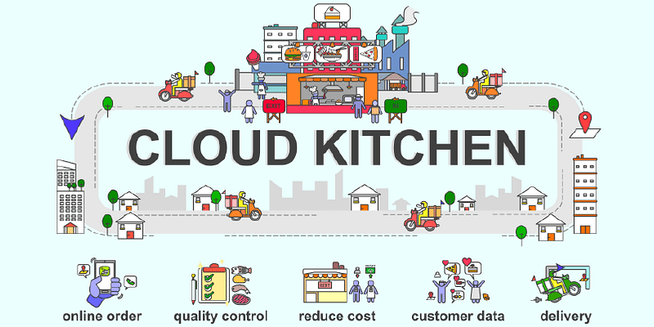
Cloud Kitchen Model

Slide 7
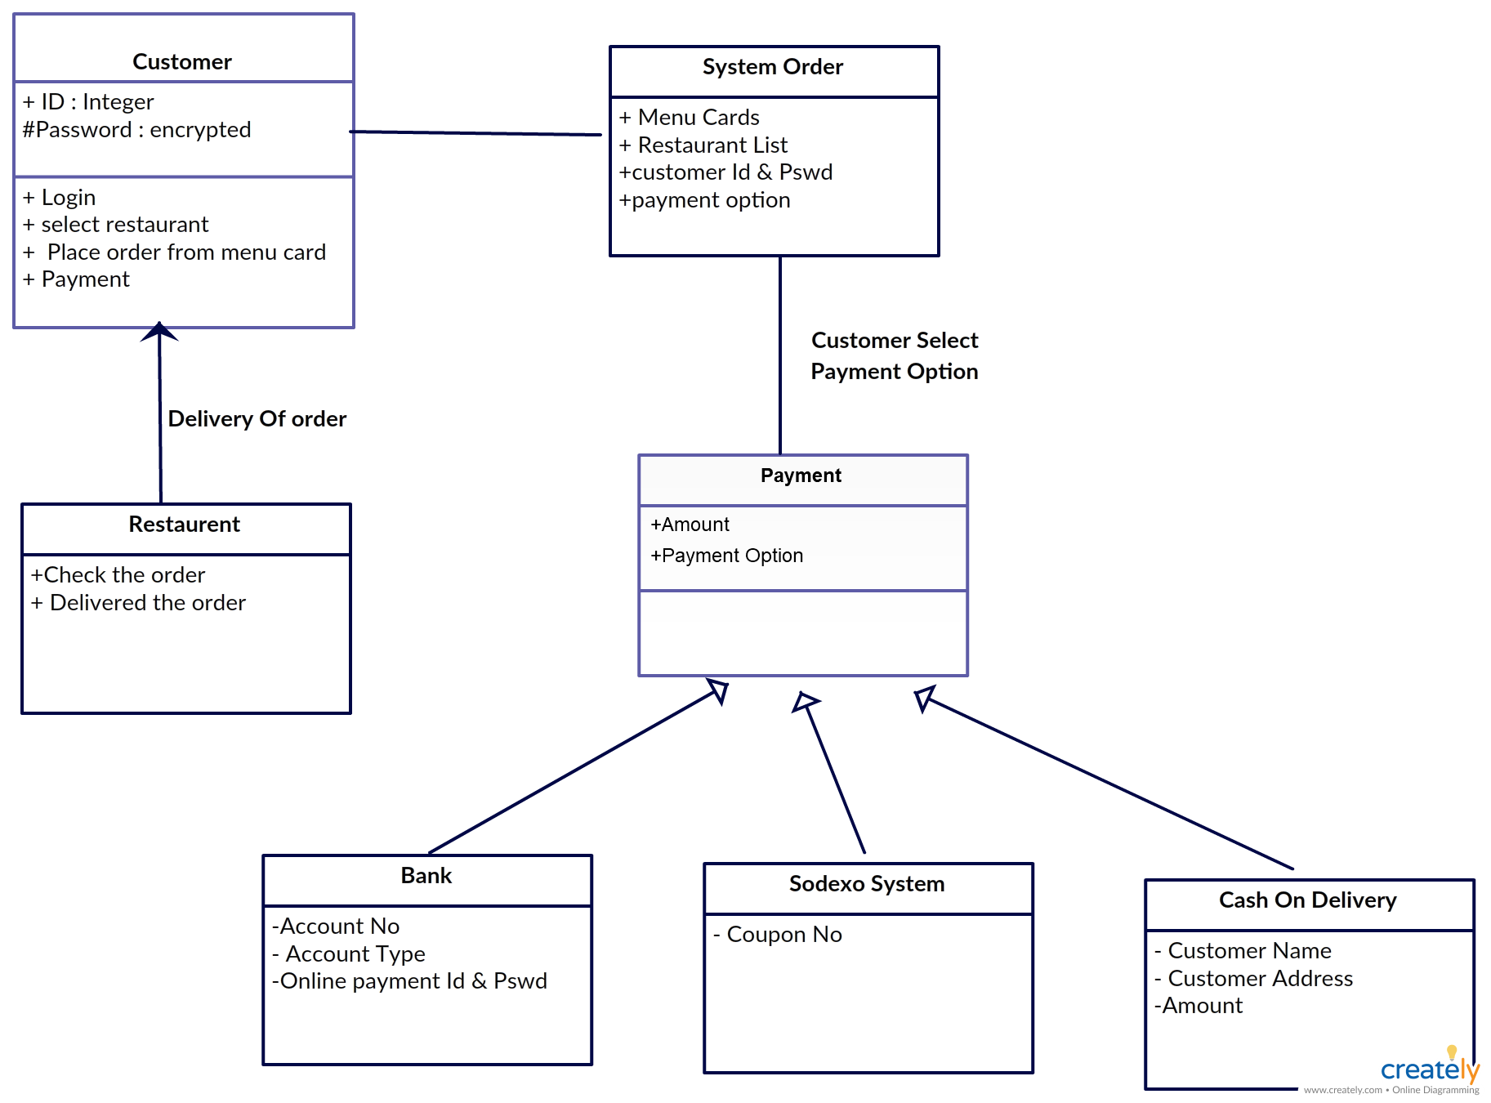
Uml Diagram

Slide 8
Libraries
To scrape the website, we will use beautifulsoup and requests module. These libraries are the bs4 and requests and modules are used for cloud kitchen.

Slide 9
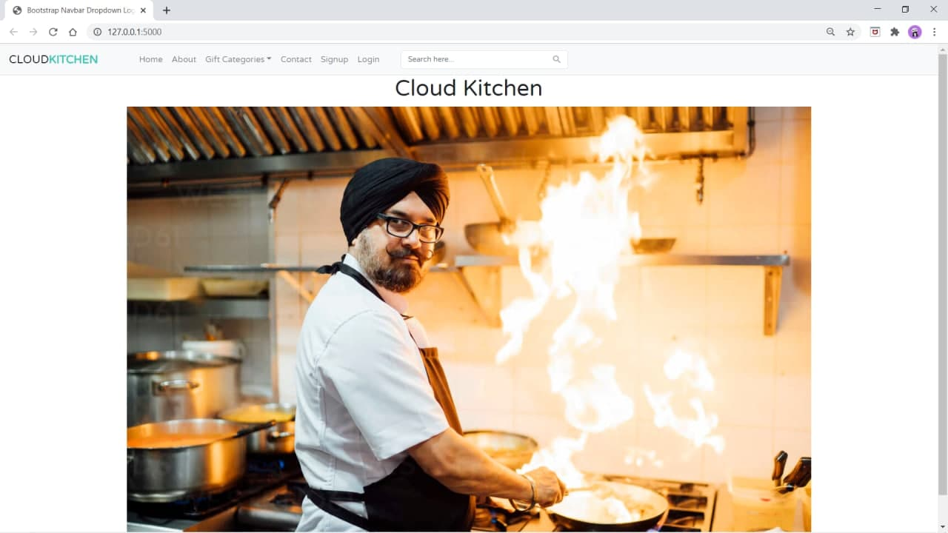

Slide 10
SYSTEM REQUIREMENTS
1.OPERATING SYSTEM : WINDOWS 7 OR ABOVE
2.DATABASE : MYSQL
3.LANGUAGE : PYTHON USING DJANGO,HTML,CSS
4.SOFTWARES : VISUAL STUDIO CODE & PYCHARM

Slide 11
HARDWARE REQUIREMENTS
1.PROCESSOR : INTEL I3 CORE MORE(MINIMUM)
2.PROCESSOR SPEED : 2.5 GHZ
3.HARD DISK : 500GB OR 1TB(RECOMMENDED)
4.RAM : 2GB

Slide 12
CONCLUSION
With the current scenario of many established and semi established restaurants, cafes shutting down, Cloud kitchen model has found a great boost. With real estate being a high cost in big cities, the concept of cloud kitchen has got many takers.

Slide 13
THANK YOU ...

